Slide 1
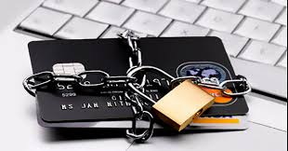


Chargebacks: EMV Liability Shift

Slide 2


Presenters
Presenters:
Georgia Stavrakis
Sr. Director of Loss Prevention
Laura J. Gaudin
Director of Product Management

Slide 3
PCI Compliancy & EMV
EMV stands for Europay, MasterCard and Visa, a global standard for inter-operation of integrated circuit cards (IC cards or "chip cards") and IC card capable point of sale (POS) terminals and automated teller machines (ATMs), for authenticating credit and debit card transactions.
Maintaining your PCI Compliancy DOES NOT require you to accommodate chip card transactions, YET.
Notes:
Laura

Slide 4

EMV Liability Shift
A traditional magnetic stripe card is swiped by the customer at a magnetic stripe terminal.
If the purchase is a counterfeit transaction, the merchant is generally not liable, just like in the past.
Notes:
Laura

Slide 5

EMV Liability Shift
A chip card is used at a traditional magnetic stripe-only terminal.
If the purchase is a counterfeit transaction, the merchant is generally holds liability, because the issuer has made the investment in chip technology to make transactions more secure while the merchant did not invest in upgrading to chip.
Notes:
Laura

Slide 6
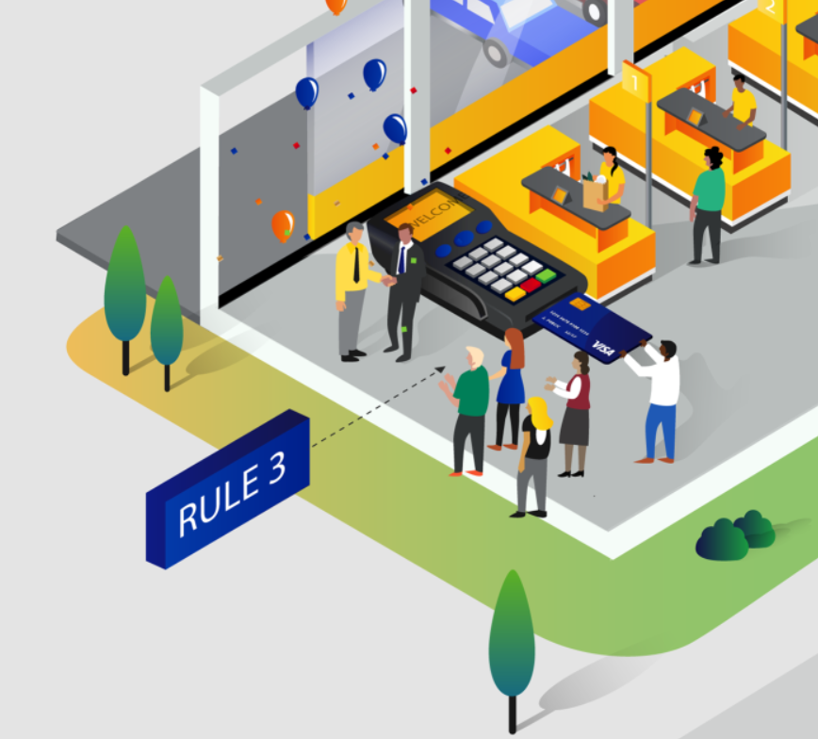
EMV Liability Shift
A chip card is used at a chip-enabled terminal that has been activated by the merchant.
If the purchase is a counterfeit transaction, the merchant is not liable, and the issuer will continue to bear the responsibility of counterfeit fraudulent activity.
Notes:
Laura

Slide 7
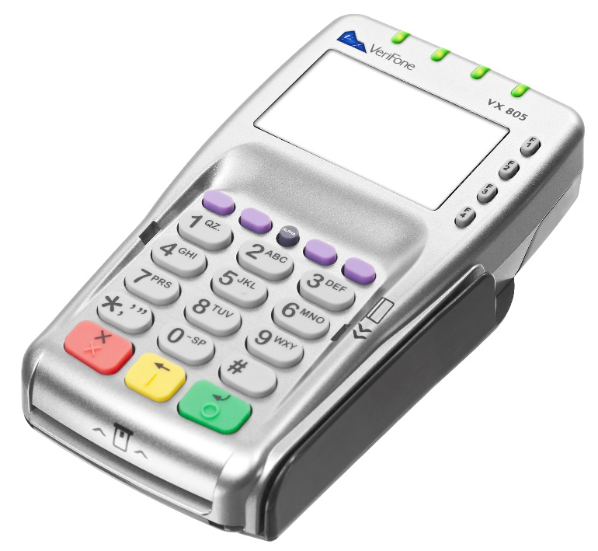
Security Benefit of Chip Technology
Chip cards protect in-store payments by generating a unique, one-time code needed for the transaction to be approved. This feature makes it virtually impossible to counterfeit cards, helping to eliminate in-store fraud.
Notes:
Laura

Slide 8
Why EMV?
More Secure Transaction
Protects against counterfeit
Deters breaches
Infrastructure enhancements
Liability Shift
Designated dispute codes
Fraud falls to the least secure technology
Cannot rebut disputes
Issuers must close reported cards
Notes:
Georgia

Slide 9
Announcement
Effective July 22, 2016, Visa & American Express will no longer allow EMV counterfeit chargebacks for sales under $25
Effective October 2016, issuers will be limited to charging back 10 fraudulent counterfeit transaction per account
Visa states that merchants can expect to see 40% fewer counterfeit chargebacks
Notes:
Georgia

Slide 10
Statistics
Restaurant counterfeit fraud:
Oct 2014 to Oct 2015 = 0.001%
Oct 2015 to present = 0.0007%
EMV chargebacks average under $50
67% of cards are EMV enabled
1.2mm merchants EMV enabled
27% decrease in counterfeit fraud from Jan 2015- Jan 2016
Notes:
Georgia

Slide 11
Trends
Top Merchant Categories:
Petroleum/Inside Sales
Restaurants/Bars
Liquor Stores
Fast Food Restaurants
High Risk Areas:
TX, NY, CA, FL, IL, NJ,
Large cities/populated areas
College towns
Foreign cards/Border areas
Counterfeit magstripe is actually an EMV
Customer used counterfeit cards for 6 years
Student printed & sold counterfeit cards in dormitory
Customer used a different counterfeit card every day
Multiple tabs on different cards
Larger orders/Catering
Long time business customer used counterfeit card
Gift cards that are actually EMV credit cards
Notes:
Georgia

Slide 12
Best Practices
Identifying Counterfeit:
Verification of last 4 digits
Compare signatures
Card identification features
CVV/CVV2/CID and/or AVS
Acceptance Options:
Stand alone EMV terminal
Middleware/PAX (pin pad connected to the POS)
Vendor certifications (inquire directly to POS)
Convert to EMV certified vendor
Processor Best Practices:
Spot checking card closures
Monitoring for issuer/customer abuse
Escalation process for patterns of misuse
Monitoring for incomplete or incorrect disputes
Notes:
Georgia

Slide 13
Benefits of upgrading to EMV processing with Revention
Removes your point of sale from scope of PCI Compliancy.
Allows you, as a merchant, to qualify for the SAQ C - PCI-DSS Self-Assessment Questionnaire.
P2PE – Point to point encryption.
NFC Processing – include Apple Pay, Google Wallet, Samsung Pay.
Supports PIN/Debit.
Chip card processing.
Notes:
Laura

Slide 14
Questions to ask when considering the EMV Upgrade
What will be the hardware investment?
When integrated with POS, which processors are supported?
Does the solution support the tips being added after the initial transaction?
When is a PIN required? How does this effect full service restaurants that don’t have table side processing?
Are your gift cards still supported?

Slide 15
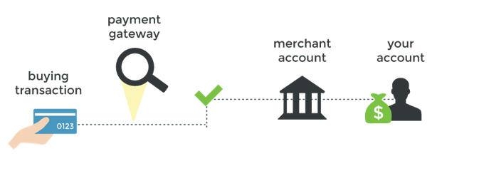
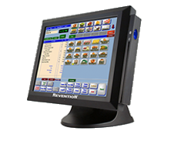
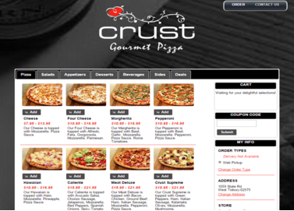

Gateway Data Flow
Notes:
Laura

Slide 16

Notes:
Laura and Georgia

